Slide 1
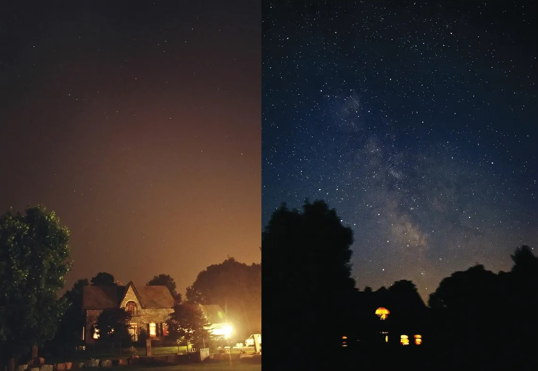
Light Pollution: An Overlooked Environmental Issue

Slide 2
Before and during the 2003 Northeast Blackout, a massive power outage on August 14, 2003, that affected approximately 55 million people across the United States and Canada.
Image courtesy Todd Carlson

Slide 3
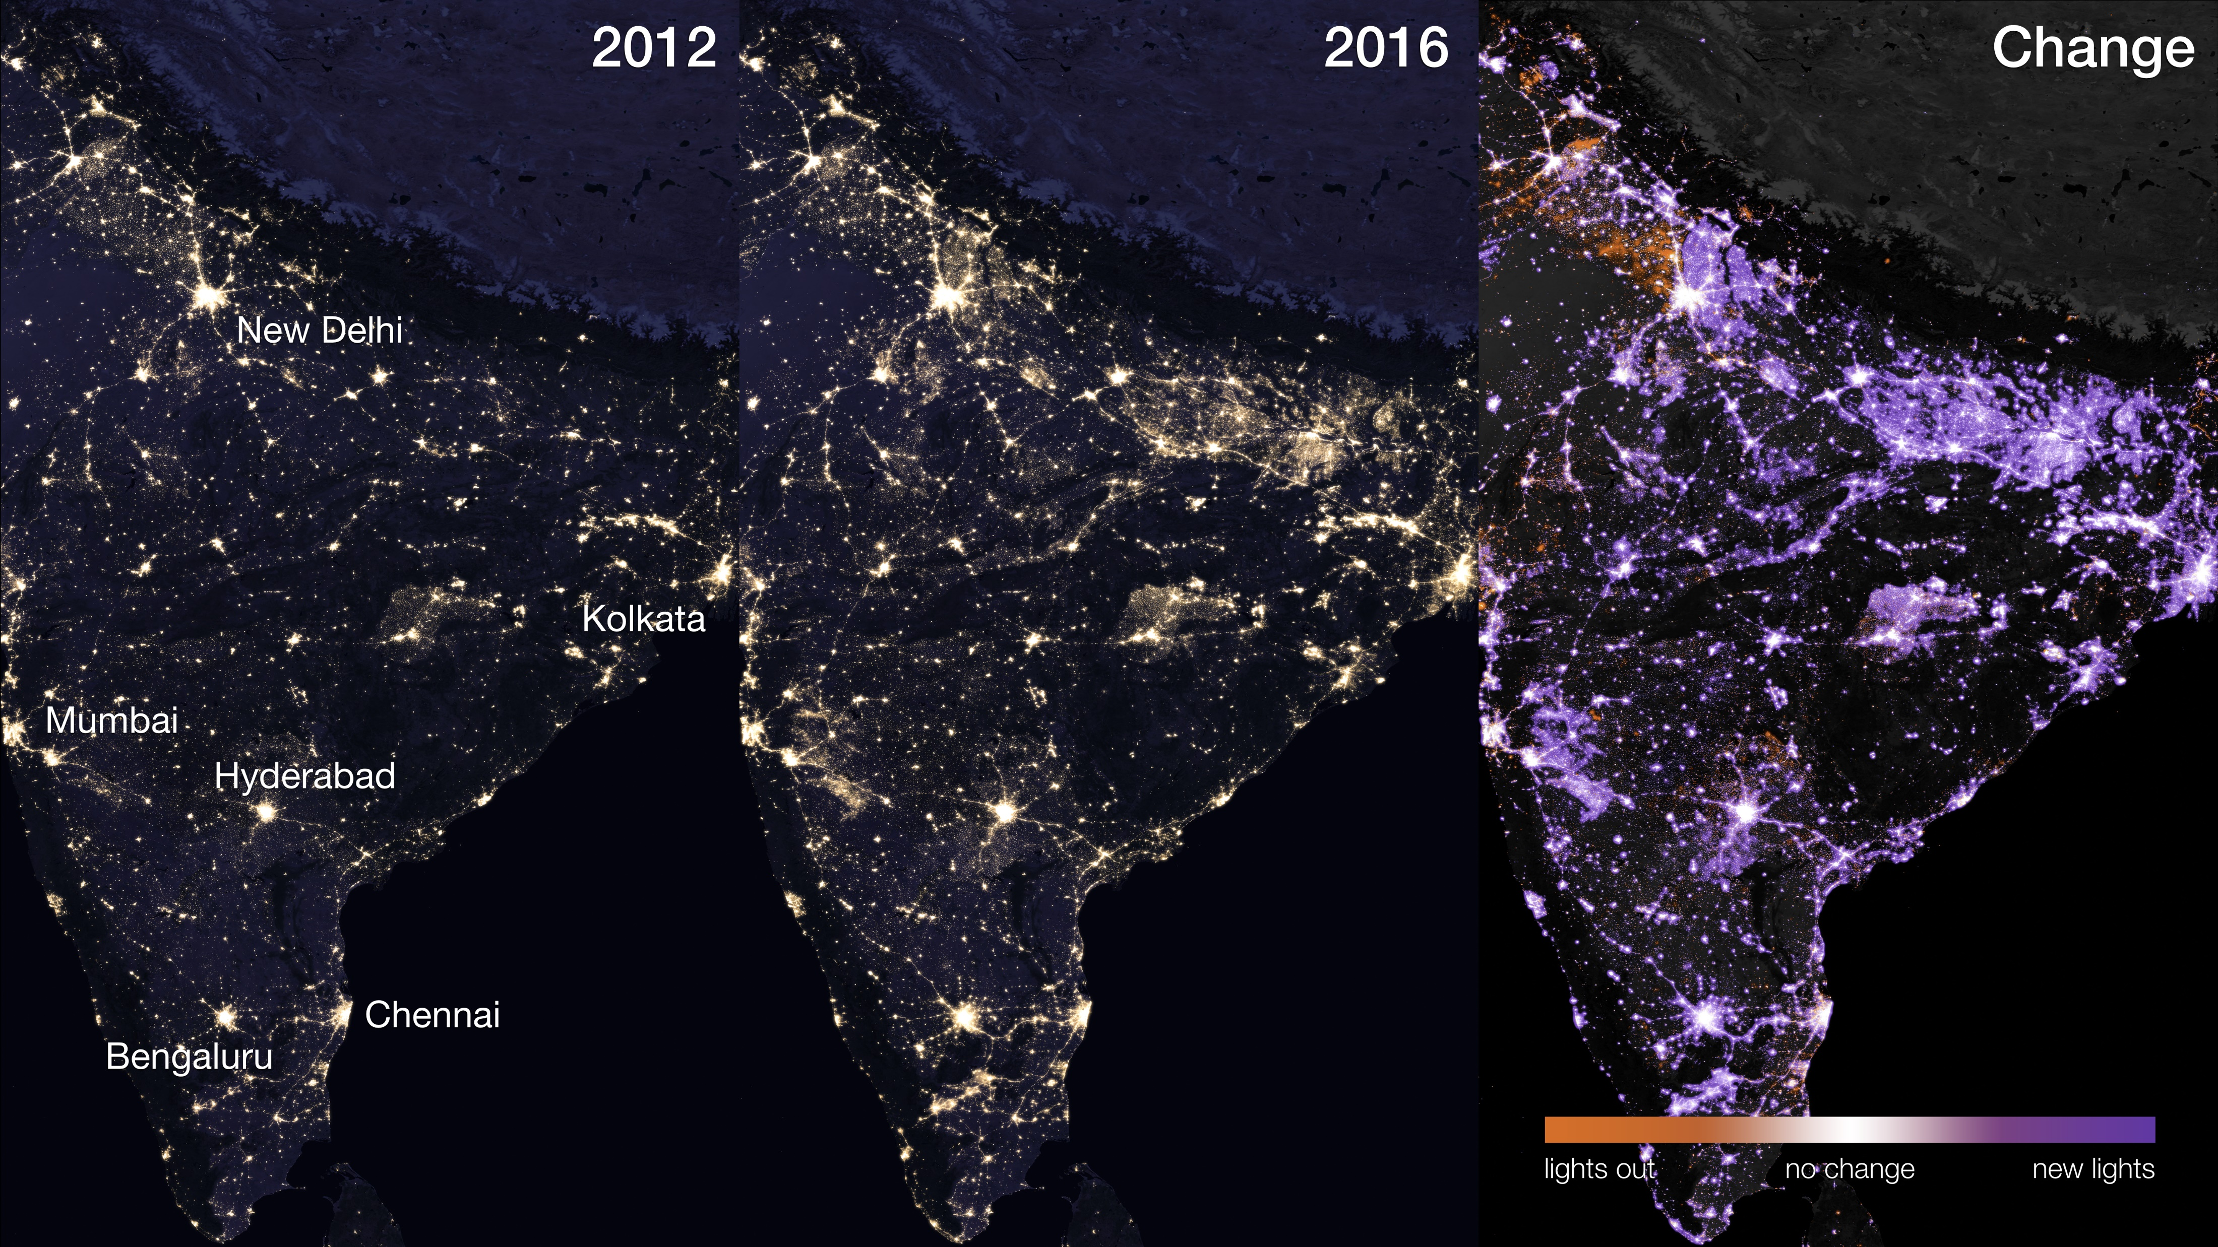
INTRODUCTION
What is Light Pollution?
Light pollution refers to the excessive, misdirected, or intrusive use of artificial light that disrupts natural darkness. It is primarily caused by streetlights, commercial signs, buildings, and vehicles, leading to environmental and health consequences.
Why Does It Matter?
Reduces our ability to see stars and celestial objects.
Disrupts wildlife and ecosystems.
Affects human sleep cycles and health.
Wastes energy and increases electricity costs.

Slide 4
What is Light Pollution?
Light pollution refers to the excessive, misdirected, or intrusive use of artificial light that disrupts natural darkness. It is primarily caused by streetlights, commercial signs, buildings, and vehicles, leading to environmental and health consequences.
Why Does It Matter?
Reduces our ability to see stars and celestial objects.
Disrupts wildlife and ecosystems.
Affects human sleep cycles and health.
Wastes energy and increases electricity costs.

Slide 5
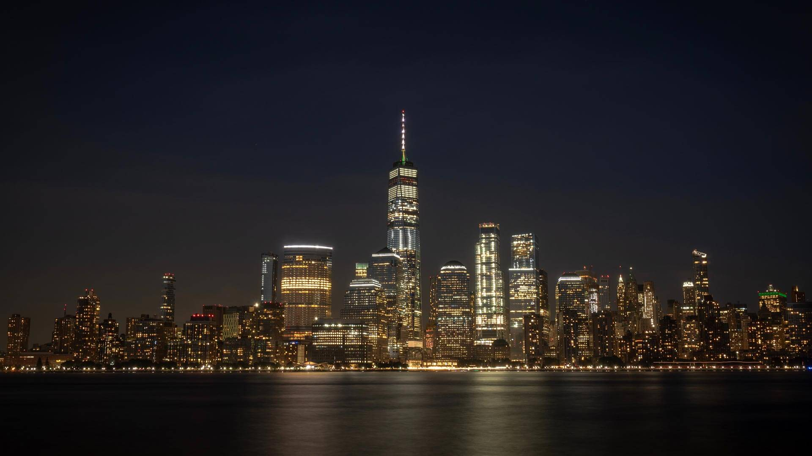
Types of Light Pollution
Skyglow: The brightening of the night sky overpopulated areas due to excessive artificial light.
Glare: Excessive brightness that causes visual discomfort, often from unshielded streetlights or headlights.
Light Trespass: Unwanted artificial light spilling into areas where it is not needed, such as streetlights shining into bedroom windows.
Clutter: Bright, excessive, and confusing groupings of lights, commonly seen in commercial districts and billboards.

Slide 6
Types of Light Pollution
NEW YORK (US)
Skyglow: The brightening of the night sky overpopulated areas due to excessive artificial light.
Glare: Excessive brightness that causes visual discomfort, often from unshielded streetlights or headlights.
Light Trespass: Unwanted artificial light spilling into areas where it is not needed, such as streetlights shining into bedroom windows.
Clutter: Bright, excessive, and confusing groupings of lights, commonly seen in commercial districts and billboards.
w/ Light Pollution

Slide 7
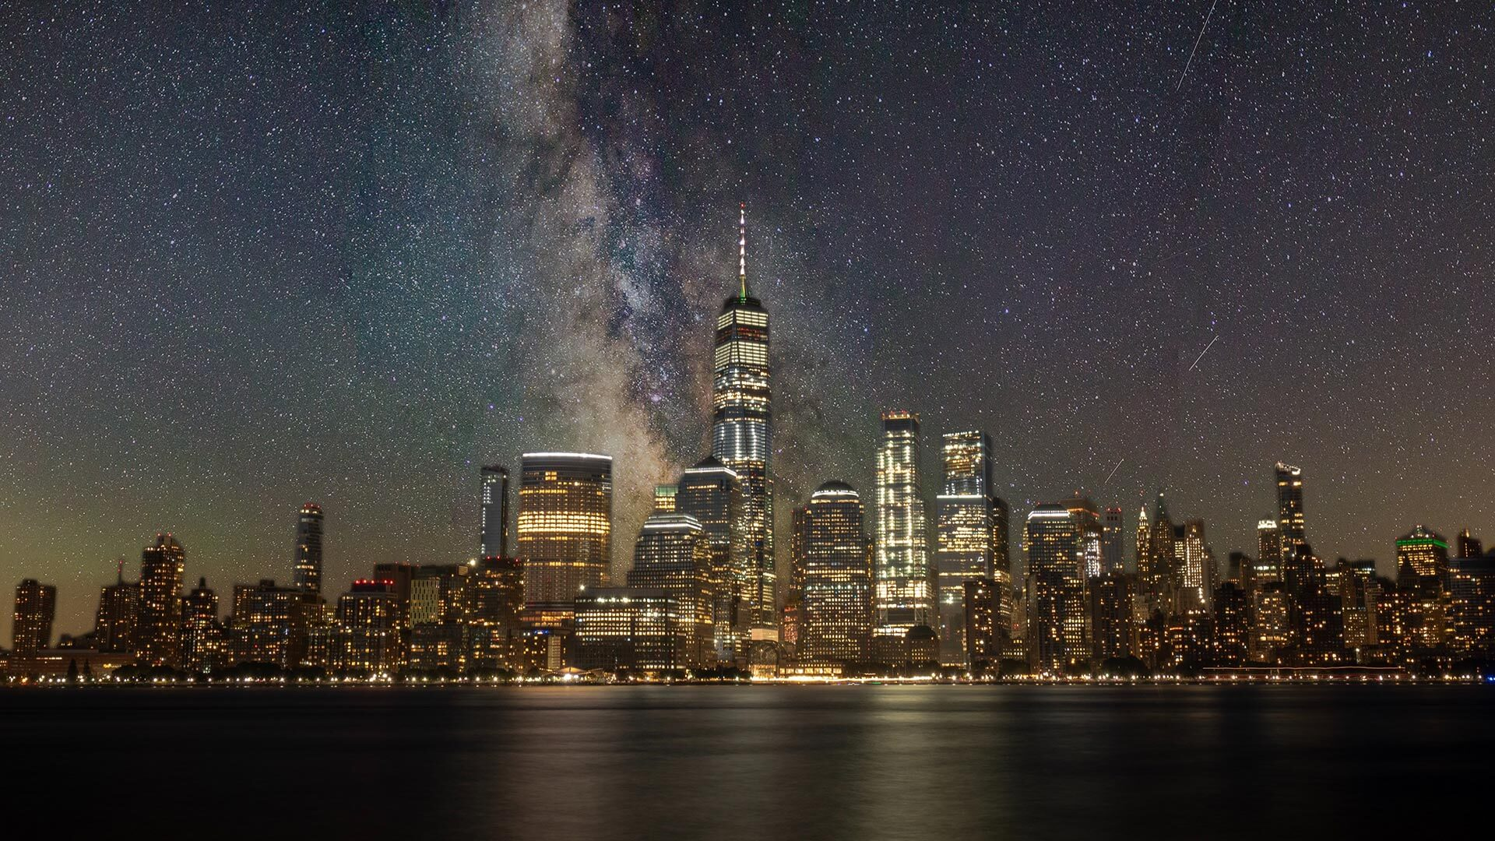
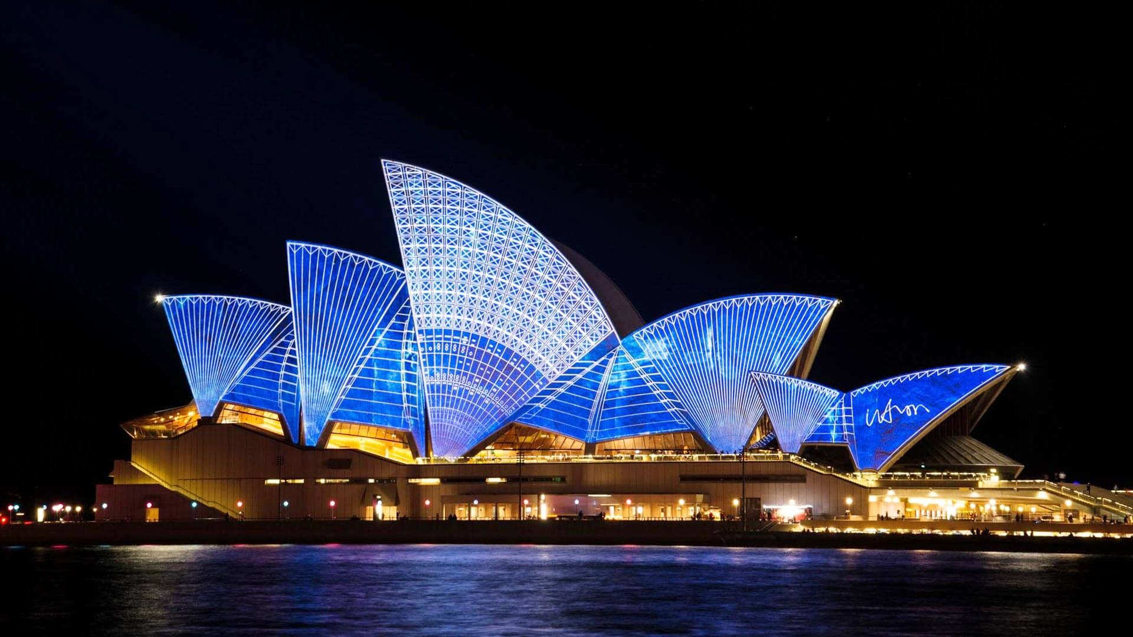
NEW YORK (US)
w/o Light Pollution

Slide 8
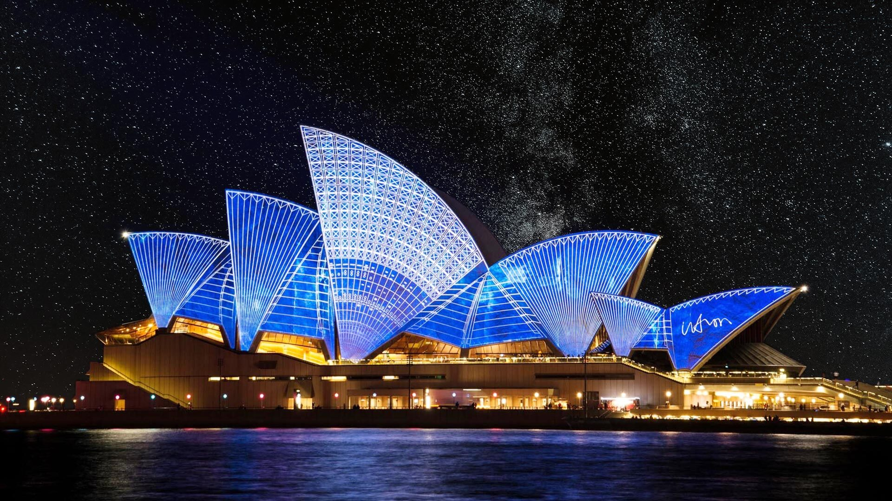
SYDNEY (AUS)
w/ Light Pollution

Slide 9
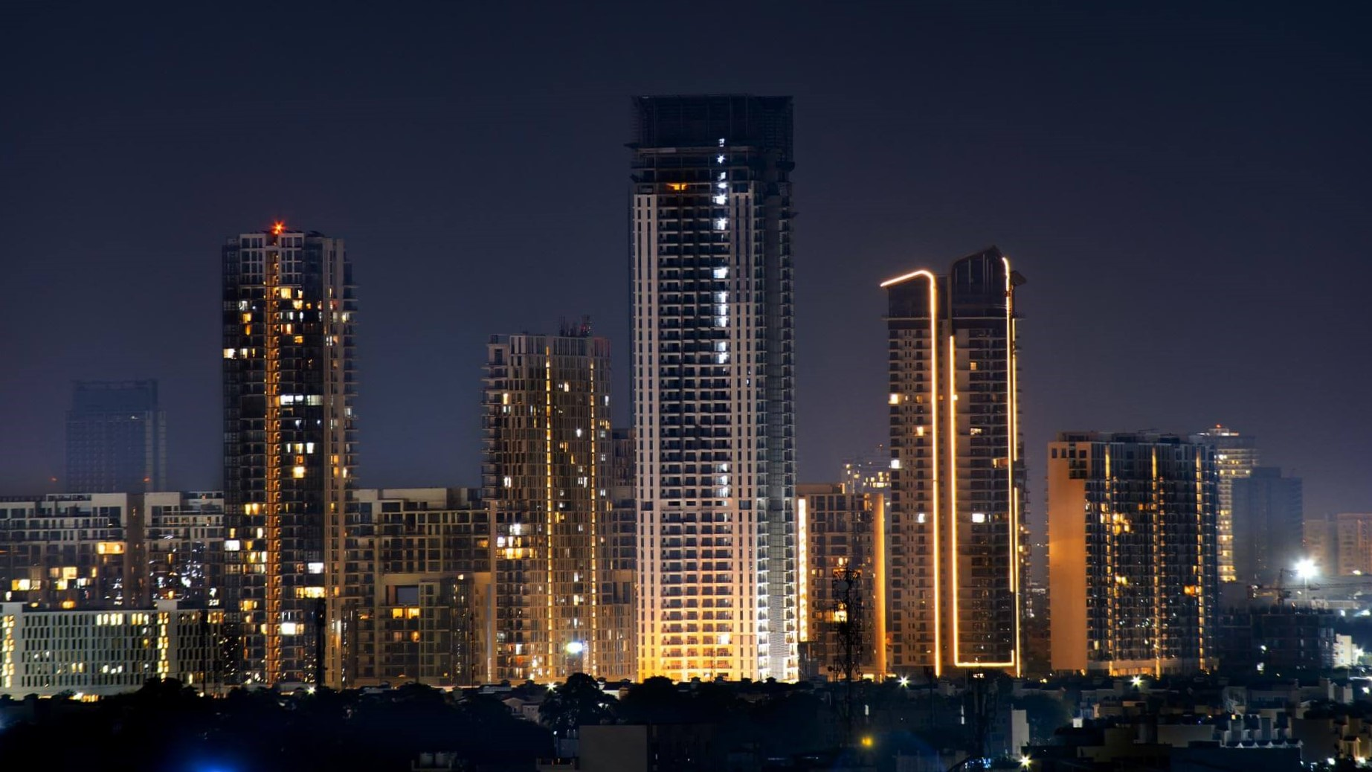
SYDNEY (AUS)
w/o Light Pollution

Slide 10
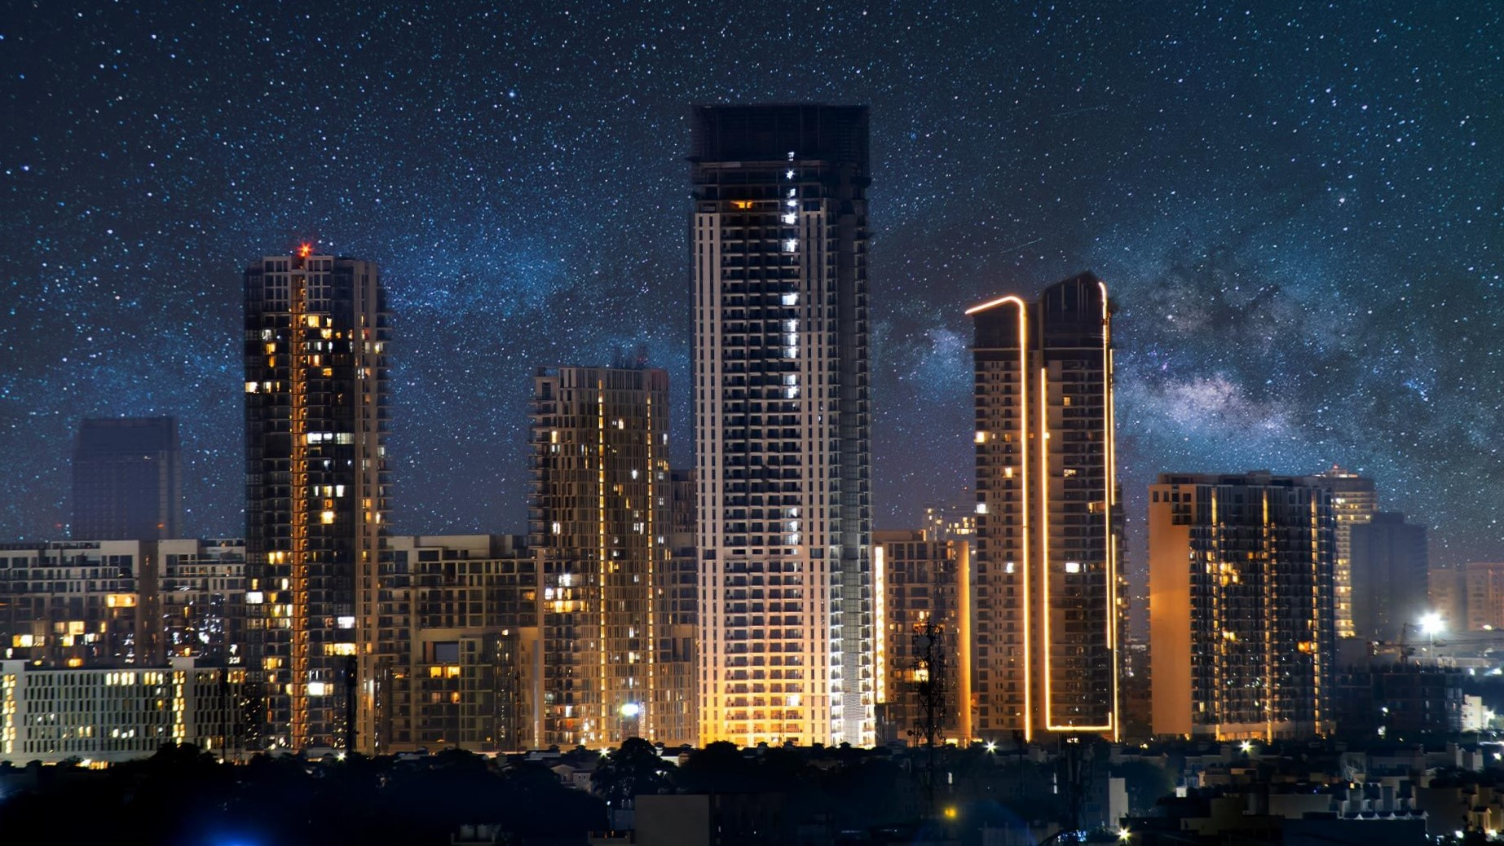
DELHI (IN)
w/ Light Pollution

Slide 11
DELHI (IN)
w/o Light Pollution

Slide 12
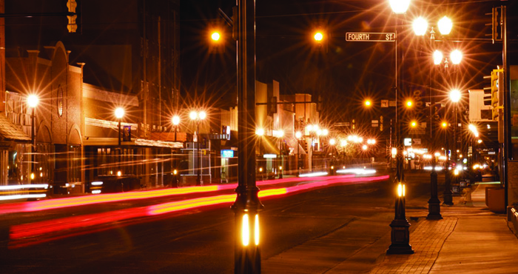
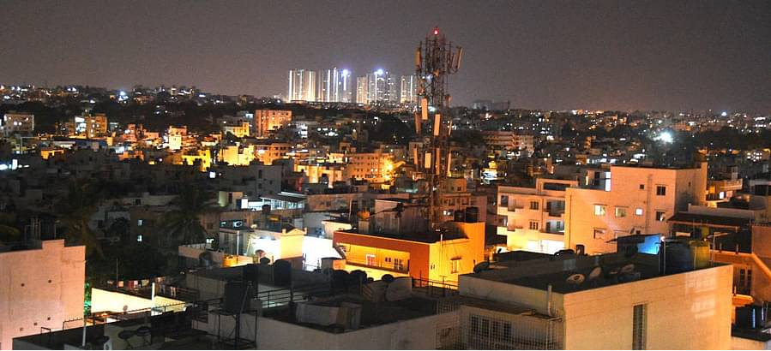
Causes of Light Pollution
Rapid Urbanization in India: With cities expanding, artificial lighting is heavily used for streets, buildings, and advertisements.
Unshielded Outdoor Lighting: Many streetlights and outdoor fixtures in Indian cities are poorly designed, directing light upward.
Festivals and Celebrations: Diwali and other festivals contribute significantly to temporary spikes in light pollution.
Commercial Hubs and Metro Cities: Places like Mumbai, Delhi, and Bengaluru have excessive billboard lighting and commercial signage.
Excessive Residential Lighting: Overuse of porch lights, security lights, and improperly aimed floodlights in urban areas.

Slide 13
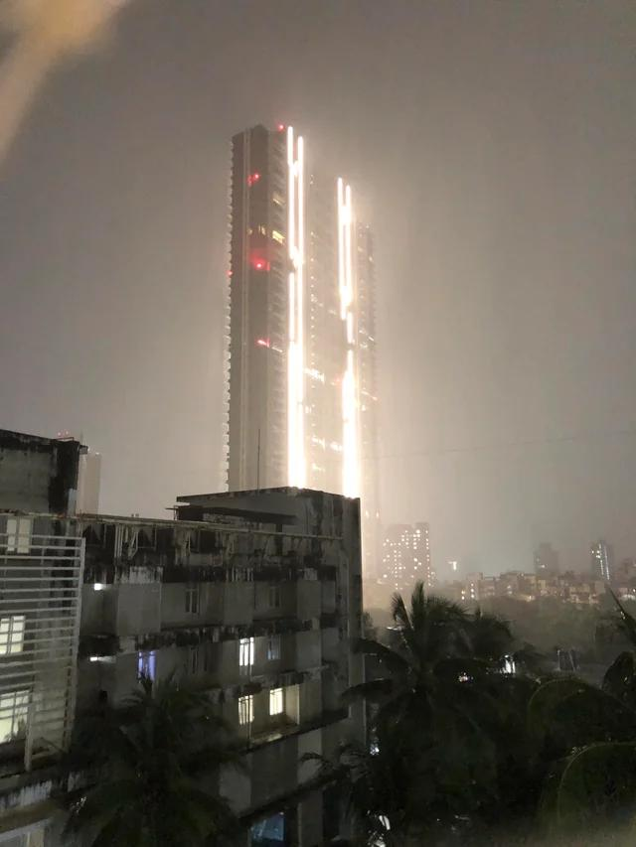
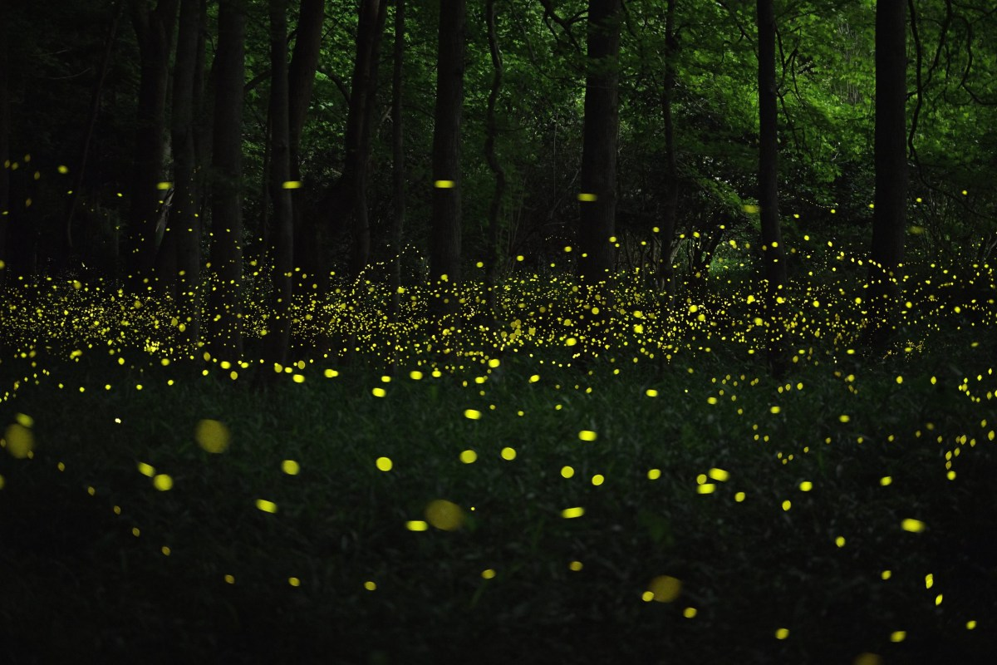
Effects on Human Health
Disrupts Sleep Patterns: Exposure to artificial light at night suppresses melatonin production, leading to insomnia, which is a growing problem in Indian urban areas.
Increases Stress & Fatigue: High exposure to LED streetlights and phone screens impacts mental well-being.
Potential Health Risks: Links between light pollution and increased risks of obesity, heart disease, and depression have been noted in Indian metro populations.
OP: Light pollution by a single building in Mumbai (it was 1 AM when this pic was taken)
Source: /r/UrbanHell

Slide 14
Effects on Wildlife
Disorients Migratory Birds: Cities like Kolkata and Chennai experience bird navigation issues due to excessive light pollution.
Affects Olive Ridley Sea Turtles: In Odisha, artificial lights from coastal areas disorient baby turtles during nesting season.
Interrupts Nocturnal Animal Behavior: Many species in India’s forests, such as leopards and owls, rely on darkness for hunting and survival, which is disrupted by artificial lighting from nearby towns and roads. Fireflies, which depend on natural darkness for their bioluminescent communication, also face population decline due to excessive artificial lighting.

Slide 15
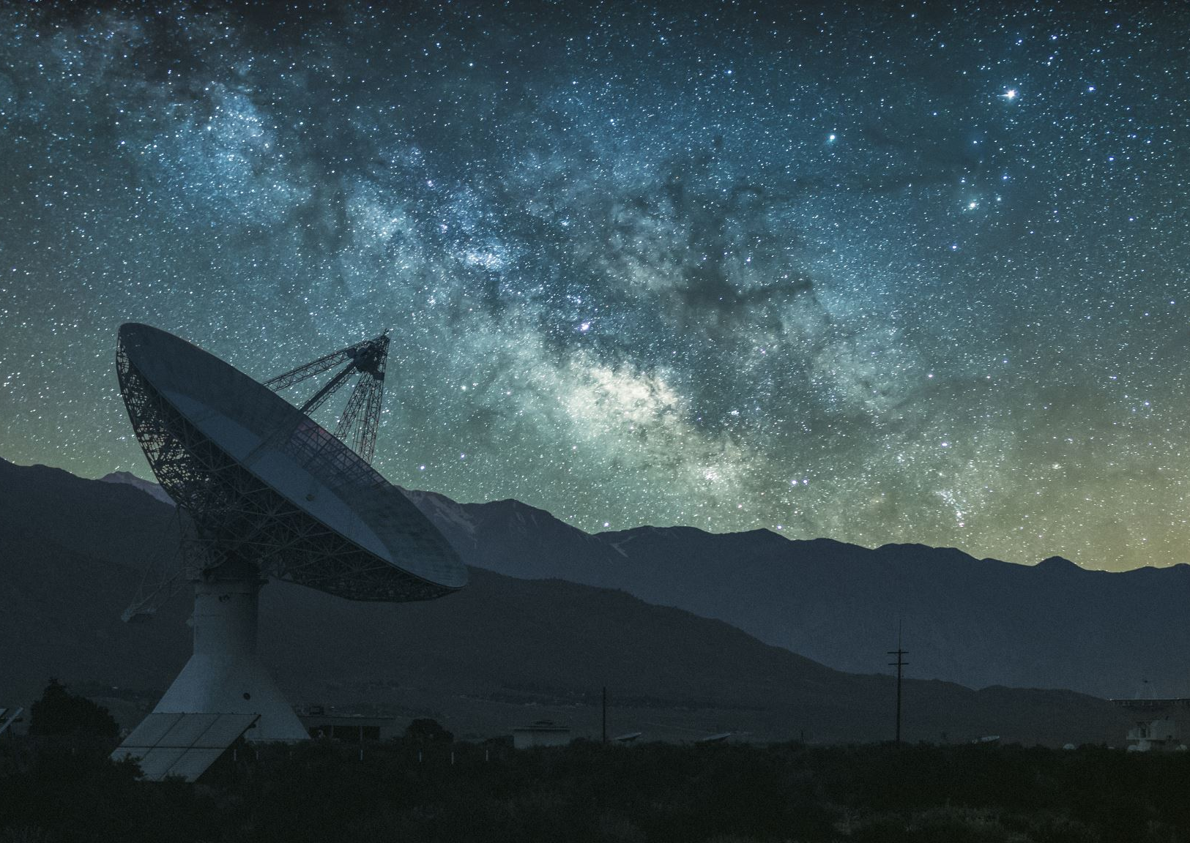
Effects on Astronomy
Skyglow Makes Stargazing Difficult: Cities like Delhi and Bengaluru suffer from excessive night-time brightness, limiting visibility of celestial objects.
Impact on Indian Observatories: Astronomers at facilities like the Indian Astronomical Observatory in Ladakh struggle to collect data due to increasing light pollution.
Cultural Significance: Many Indian mythologies reference celestial navigation, but modern light pollution reduces public engagement with the night sky.

Slide 16
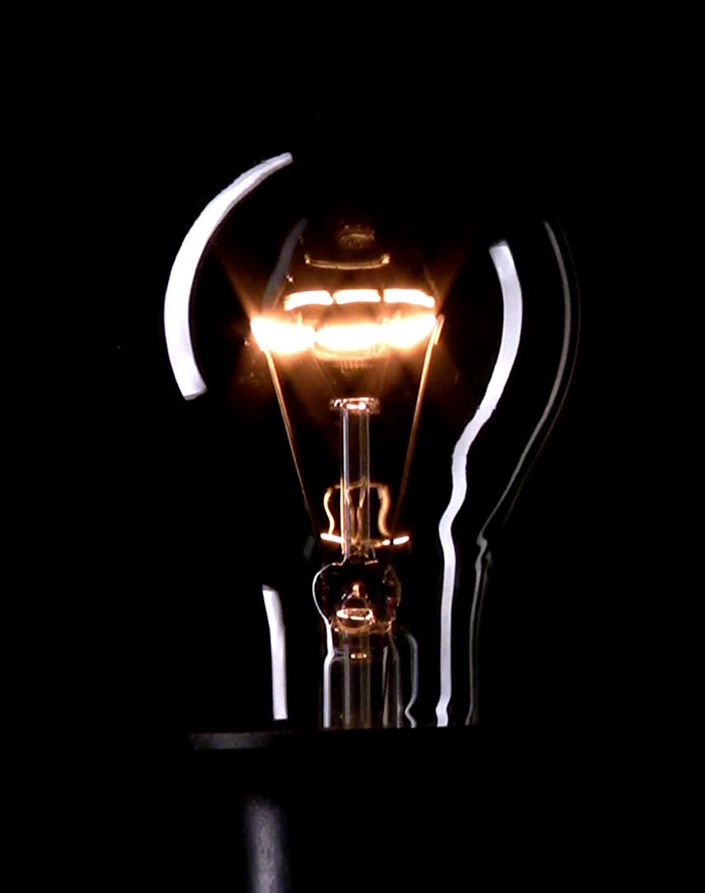
Energy Waste and Economic Impact
Wasted Electricity: India has one of the highest electricity consumption rates due to inefficient lighting.
Impact on Rural and Urban Divide: While rural India still faces power shortages, urban areas waste energy through excessive lighting.
Solutions: Implementing LED lights, motion sensors, and efficient lighting policies in Indian cities can help reduce energy waste.

Slide 17
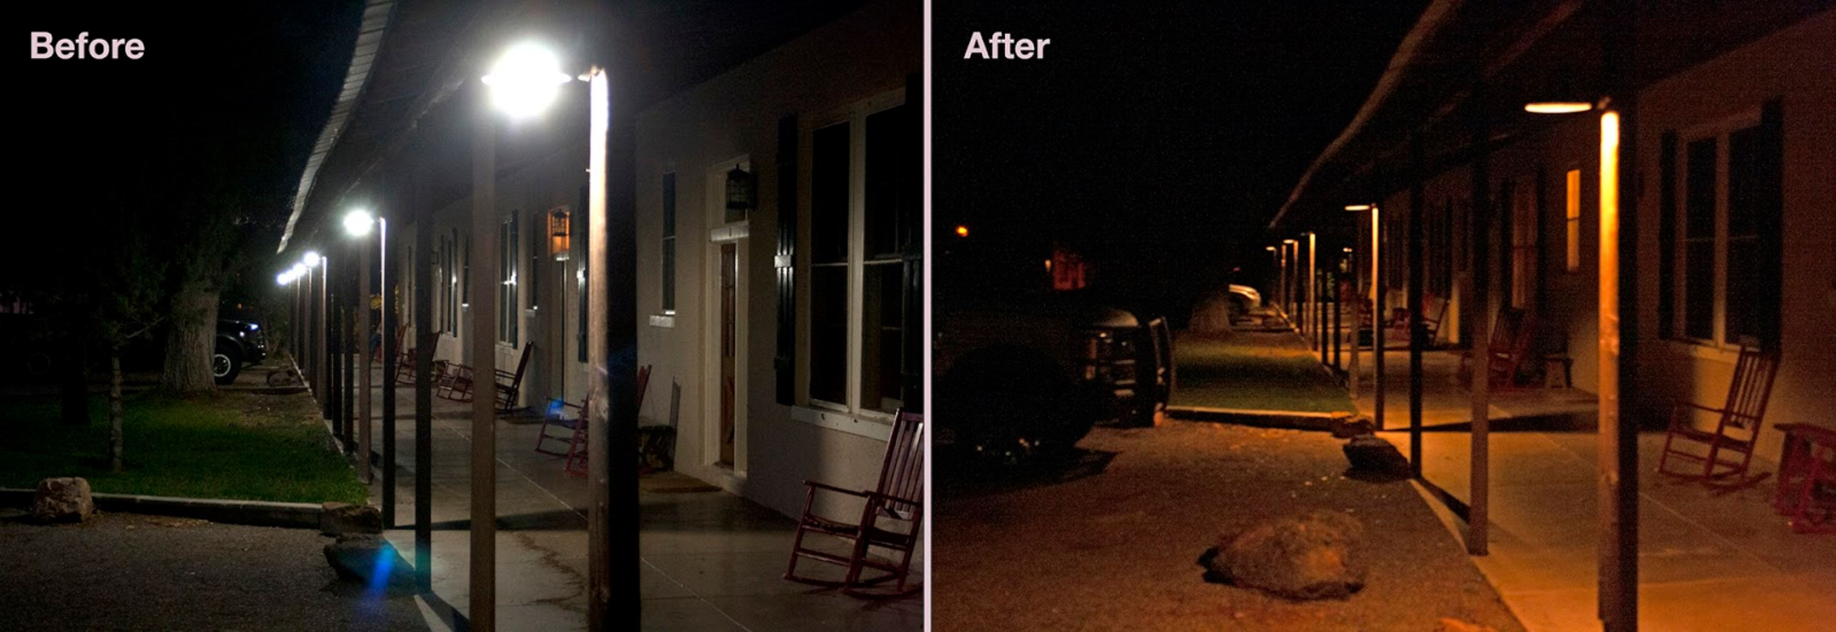
Solutions to Light Pollution
Use Shielded Streetlights: Several Indian cities are now replacing traditional lights with downward-facing LED fixtures.
Regulating Festival Lighting: Efforts to reduce excessive lighting during festivals like Diwali can help minimize light pollution.
Awareness Campaigns: Indian environmental organizations promote dark sky awareness programs to educate the public.

Slide 18
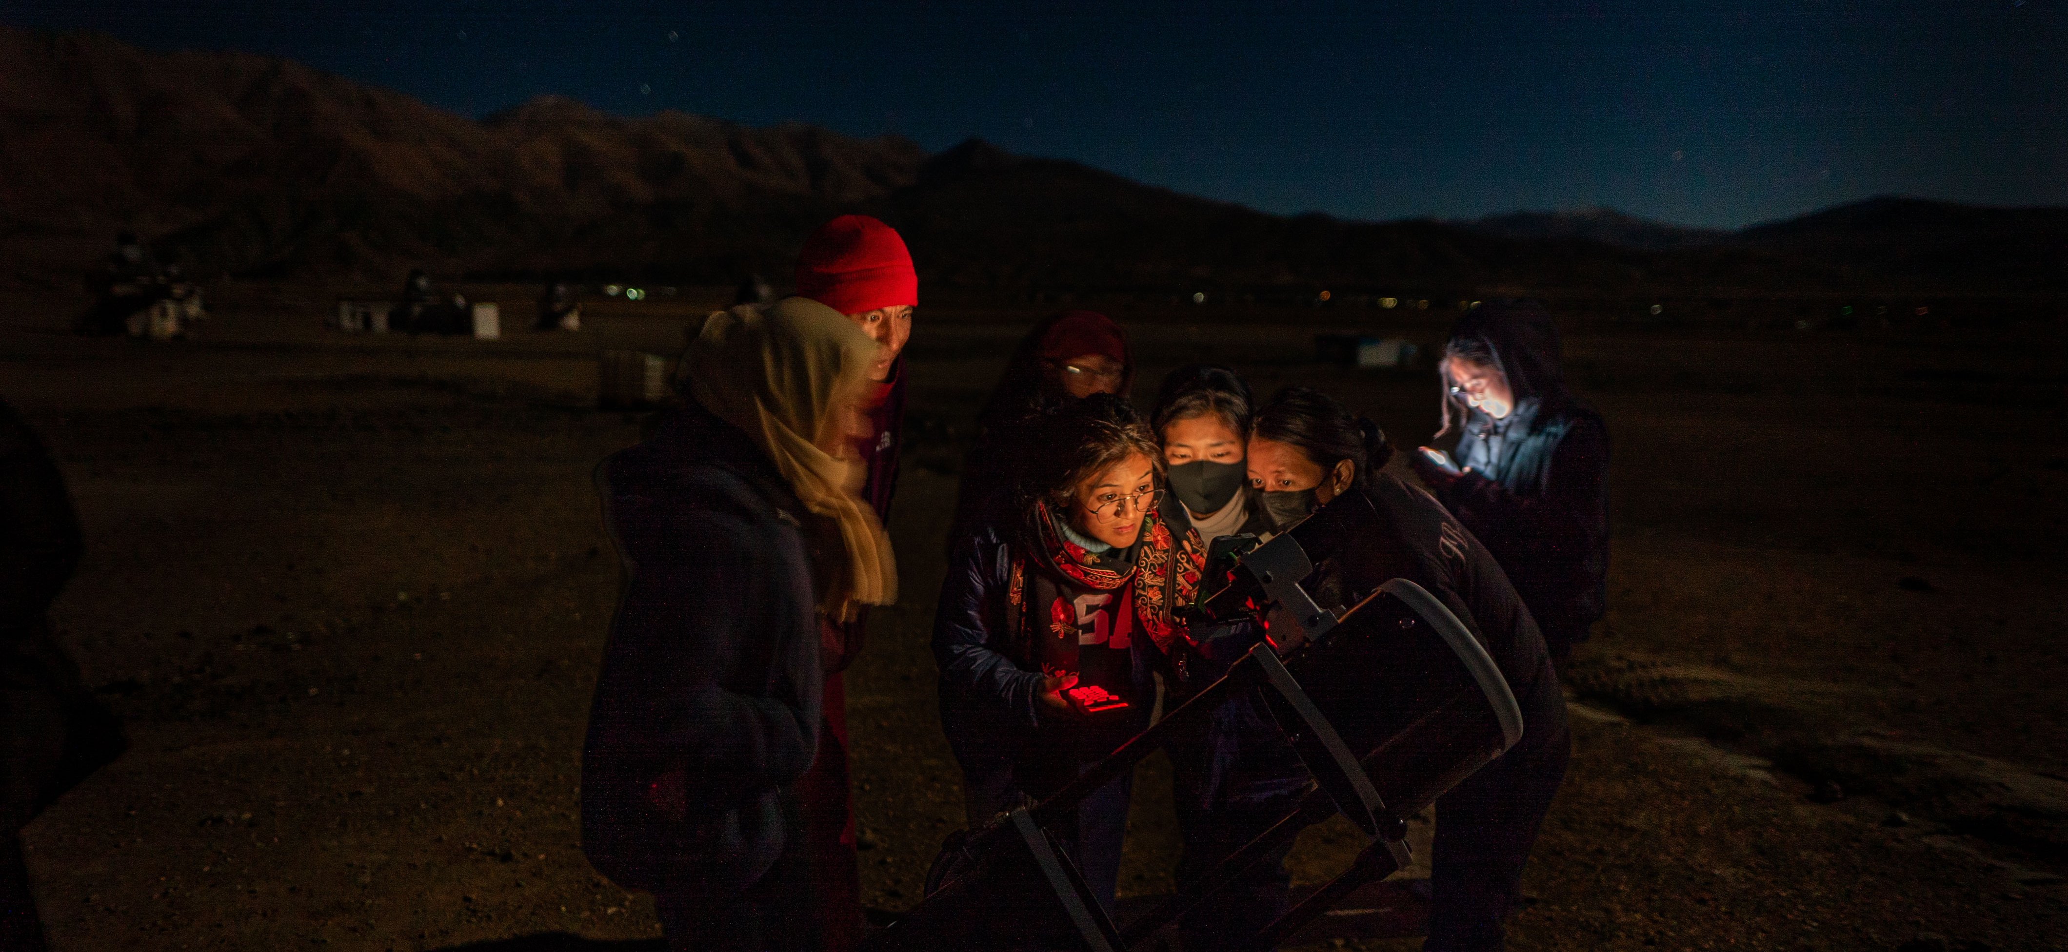
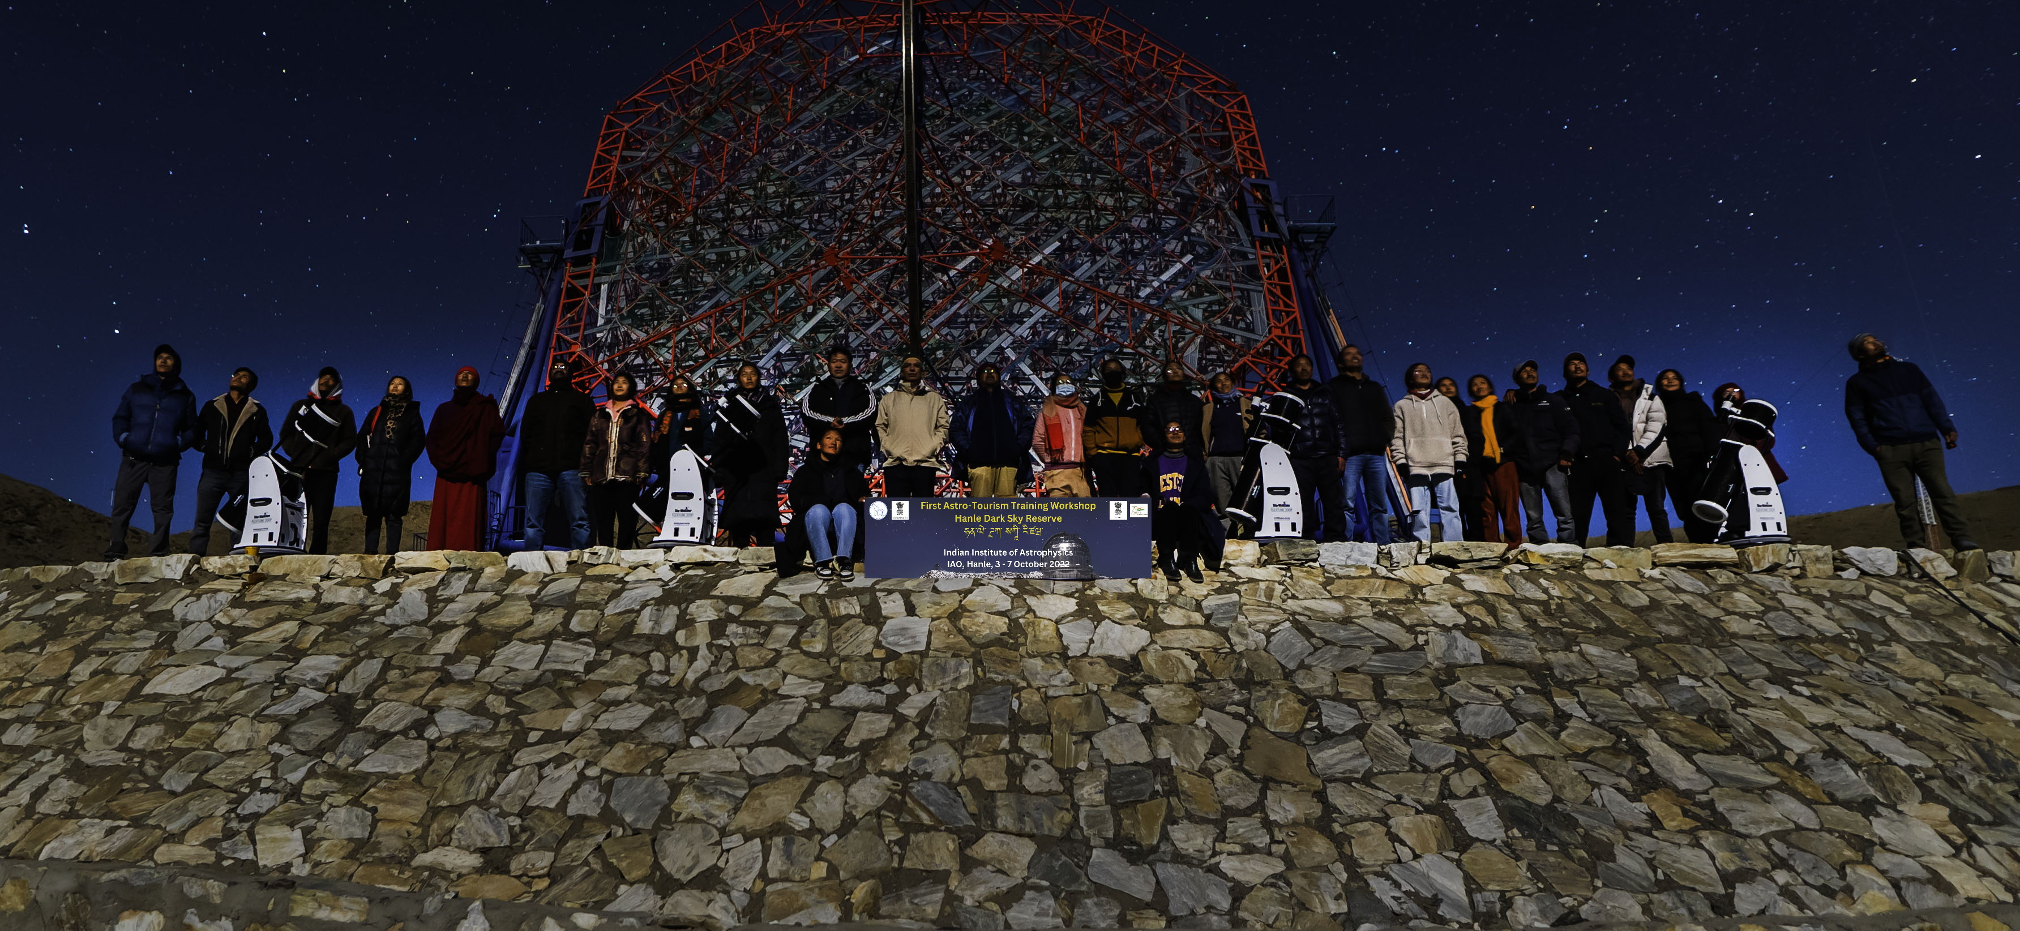
Case Studies & Success Stories
Image source: HDSR (IIA)
Ladakh’s Dark Sky Reserve: India’s first Dark Sky Reserve aims to preserve natural darkness for astronomy and wildlife.
Smart Lighting Policies in Indian Cities: Bengaluru and Pune have initiated controlled lighting projects to reduce skyglow.
Conservation Efforts in Coastal Areas: Odisha has implemented reduced artificial lighting in turtle nesting zones.

Slide 19
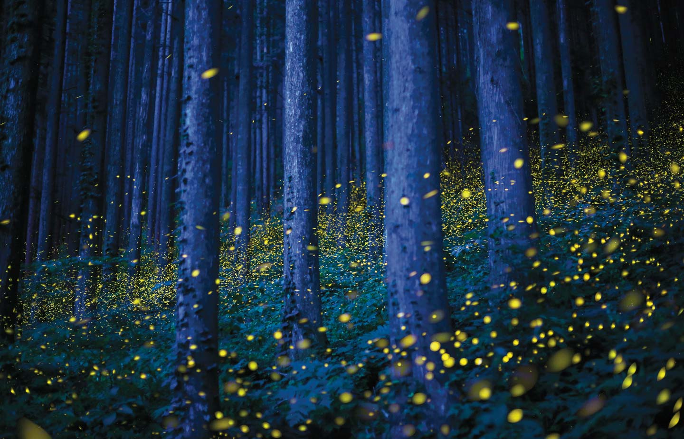
Conclusion
Summary of Key Points:
Light pollution disrupts ecosystems, affects human health, and wastes energy.
In India, urbanization, festivals, and commercial lighting contribute significantly.
Wildlife, including fireflies, migratory birds, and sea turtles, are particularly affected.
Call to Action:
Implement responsible lighting policies and awareness campaigns.
Use energy-efficient and shielded lighting.
Encourage community efforts to reduce unnecessary artificial lighting.

